Slide 1

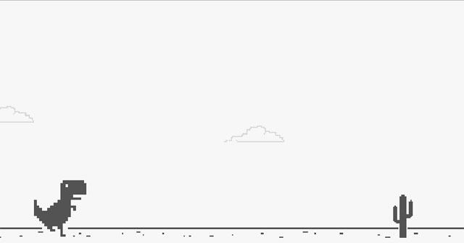

Capstone Final Presentation
(DINO RUN PROJECT)
Alvin Henry 100709877
Nikhil Aleti 100851159
Dhvani Mevawala 100827131
Drasti Sutrariya 100850377
Rushikumar Patel 100852498

Slide 2
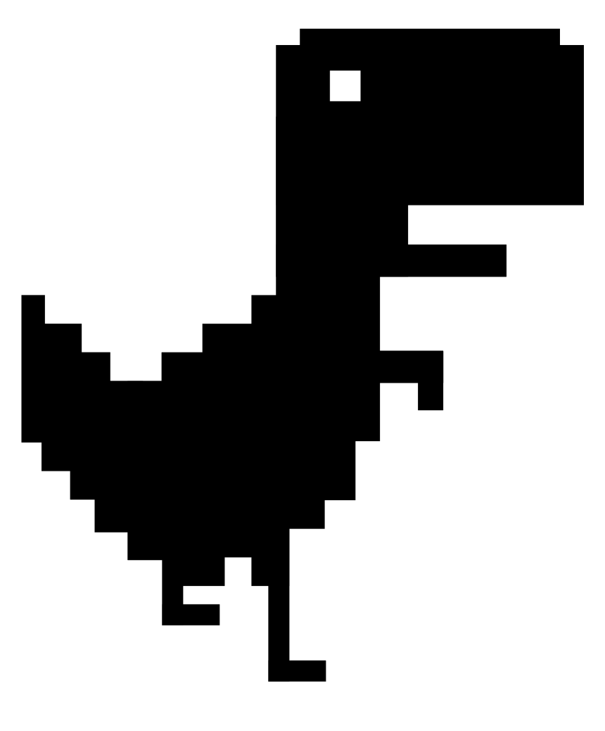


Introduction
The Google-created browser game The Dinosaur Game, sometimes referred to as the Chrome Dino, is included with the Google Chrome web browser. The basic objective of the game is to move the pixelated Tyrannosaurus rex forward while dodging the hazards in its path.
Members of the Chrome UX team built the game in 2014.
Google Chrome warns users that they are not connected to the Internet when they try to access a website while offline by displaying an image of a pixelated Tyrannosaurus dinosaur on the page.

Slide 3

How to Play this game
The player must jump or duck to avoid encountering Pteranodons and cacti as the Lonely T-Rex wanders continuously from left to right over a black-and-white desert terrain.
On devices, using the spacebar, ↑, or tapping the dinosaur will make it ”leap“, whereas pressing the ↓ key will make it "duck." The pace of play gradually picks up as the game goes on until the player encounters a barrier.
We created the game such that if the user begins playing after 4p.m. until 5a.m., the mode will be dark, and the other times of the day will be light/day mode.

Slide 4
GAME Implementation
Using Python's pygame package, we built our own gaming console for the Dino Run game. In this Dino Run Game, we implemented the N.E.A.T (Neuro Evolution of Augmenting Topologies) algorithm to apply Artificial Intelligence.
In a nutshell, this implementation creates objects for the Dino, the Cactus, the birds, the Ground, and the Scoreboard.
The T-rex moves from left to right of the screen by avoiding the obstacles.
The obstacles include cactus and the birds – cactus can be avoided by jumping over them while birds are avoided by either jumping or ducking depending on the height of the birds in the sky.

Slide 5

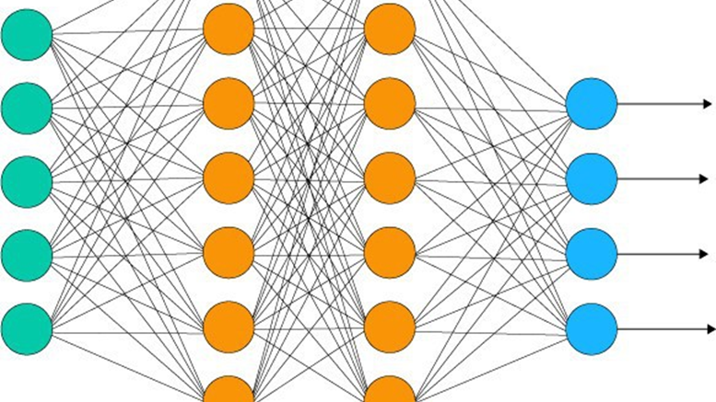
N.E.A.T
Ken Stanley created the Neuro Evolution of Augmented Topologies genetic algorithm to produce developing artificial neural networks.
NEAT's algorithm is configured to evolve minimal networks by starting all networks with no hidden nodes. Each individual in the initial population is essentially a set of connecting genes between input and output nodes.
Will be important for the Dinosaur game, only input and output neurons are instantiated. Afterwards several networks will start playing the game and learning with crossover typical of genetic algorithms and classic selection.
Score performed during each generation will give a value expressive of the network’s goodness.

Slide 6

CODE

Slide 7
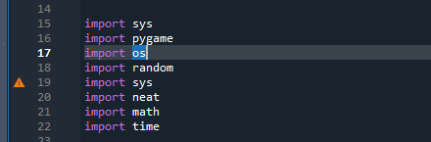
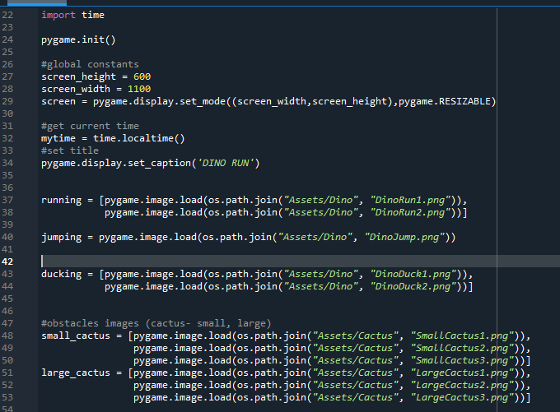

Slide 8
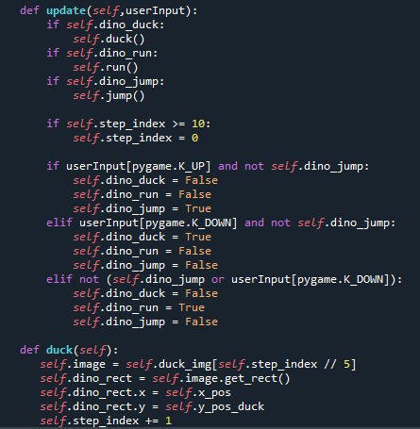
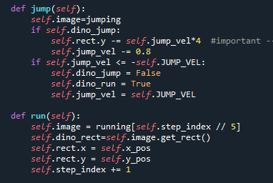
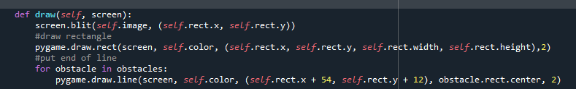

Slide 9
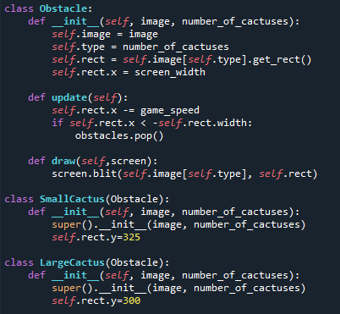
Obstacle class

Slide 10
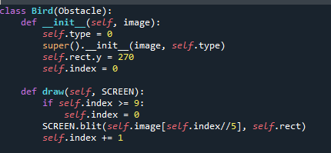
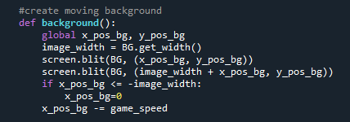
Bird class
Moving background

Slide 11
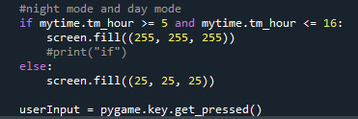
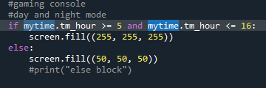

Slide 12
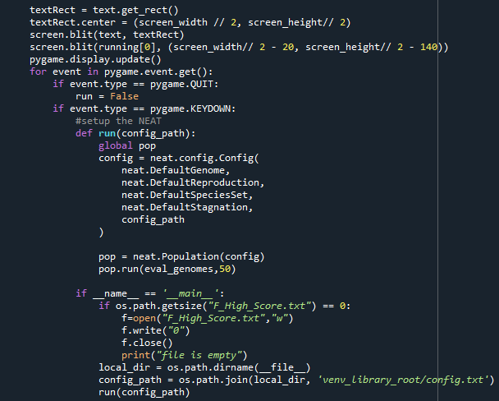
N.E.A.T

Slide 13
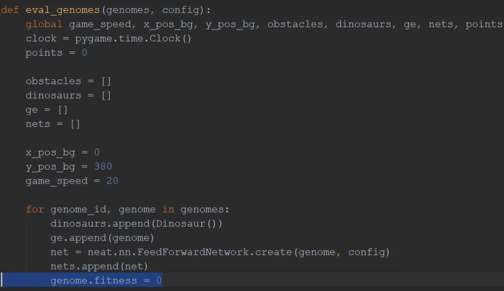
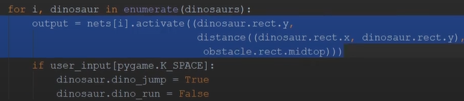

Slide 14
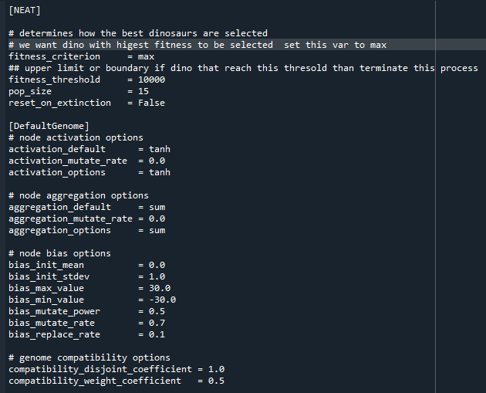
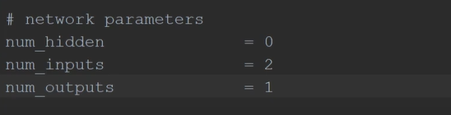
Config file

Slide 15
Problems faced
Duck problem
Interface problem when its not responsive
Highest score

Slide 16

Thank You Here is a demo

Slide 17
References and Github Link to code
Wikimedia Foundation. (2022, August 4). Dinosaur game. Wikipedia. Retrieved August 5, 2022, from https://en.wikipedia.org/wiki/Dinosaur_Game#:~:text=The%20Dinosaur%20Game%20(also%20known,to%20achieve%20a%20higher%20score.
Neat overview¶. NEAT. (n.d.). Retrieved May 25, 2022, from https://neat-python.readthedocs.io/en/latest/neat_overview.html
https://github.com/rushi-patel-347/DINO_RUN_CAPSTONE_PROJECT.git

